Slide 1
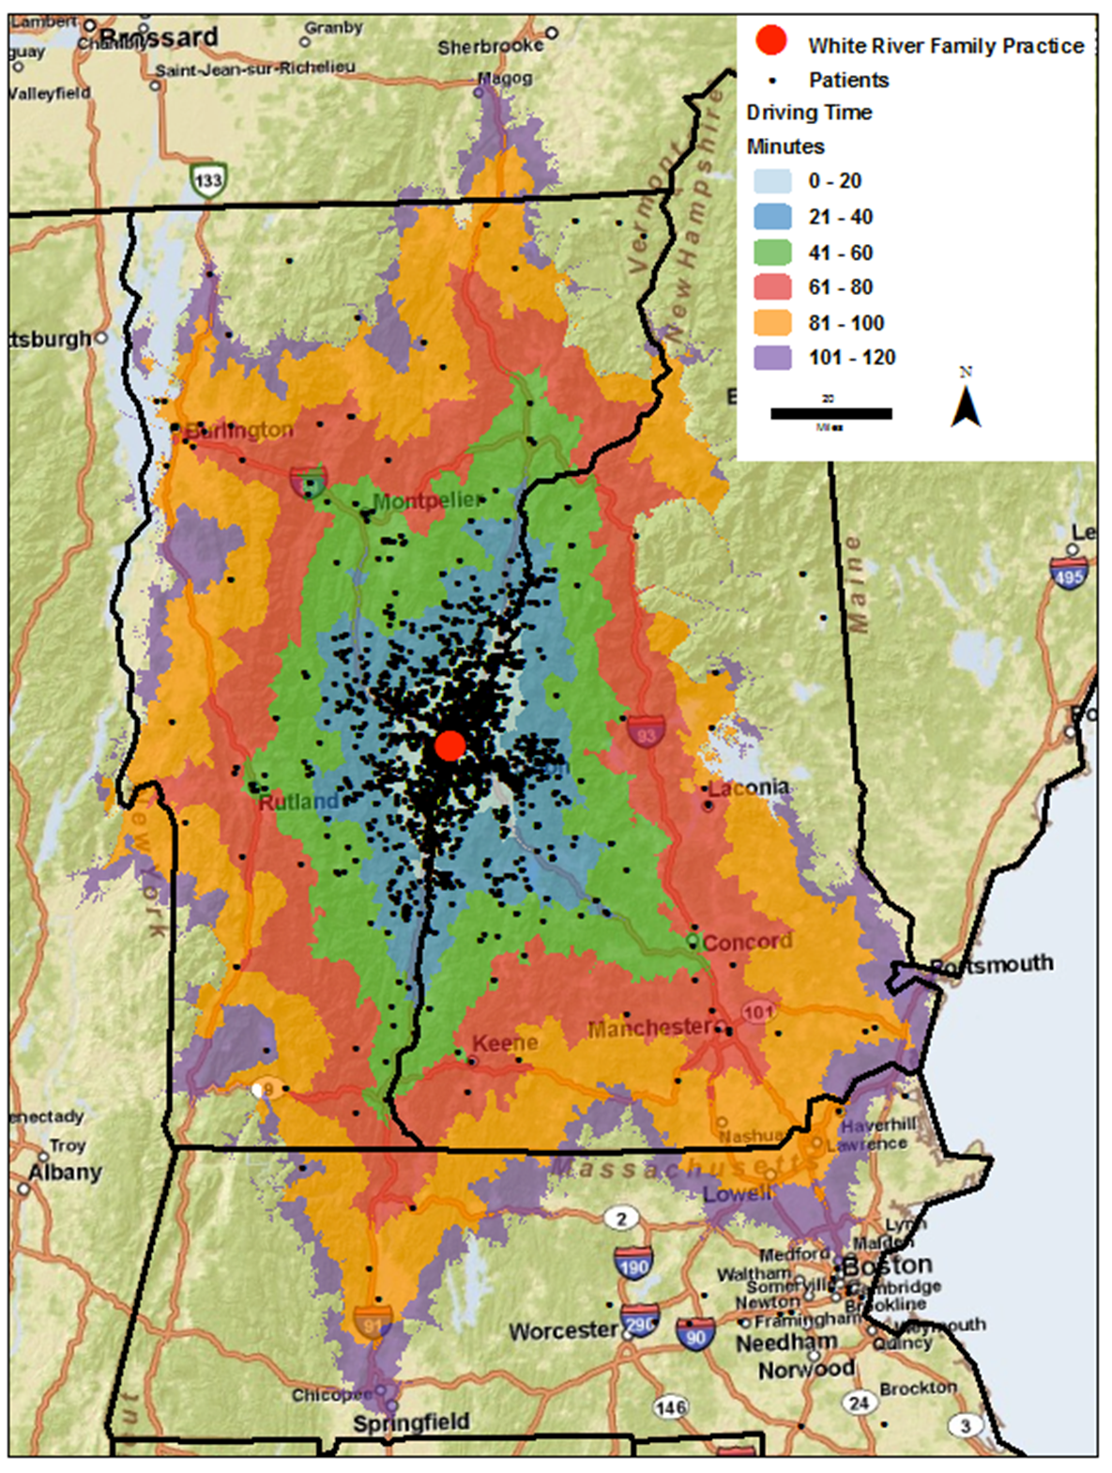
White River Family Practice:
6 FP’s, 3 NP’s (5.5 FTE’s)
~10,000 patients
eClinicalWorks – 4/10
Quest Lab Interface
Patient Portal
MU, yrs. 1, 2, & 3
Level 3 PCMH, 9/12
Davies Ambulatory Award, 2013
Notes:
Blueprint for Health, State of Vermont
Geisel School of Medicine at Dartmouth

Slide 2
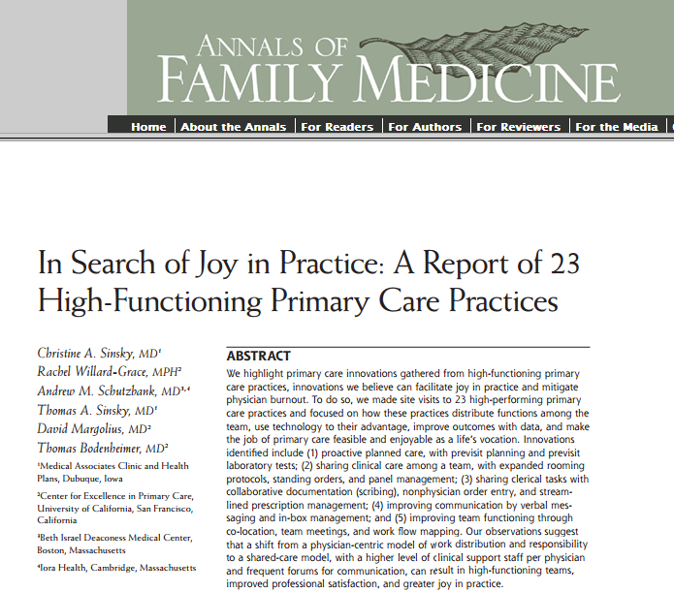
Ann Fam Med May/June 2013 vol. 11 no. 3 272-278
Notes:
See next slide…

Slide 3
Joy in Practice…
Proactive planned care
Pre-visit planning and lab tests
Sharing clinical care among team
Expanded rooming protocols
Standing orders
Panel management
Sharing clerical tasks
Rx management
Non-physician order entry
Improved communication
Verbal messaging & in-box management
Improved team functioning
Team meetings
Work-flow mapping
Notes:
Many of these functions are enabled by (or require the capability of) concurrent care by all members of an office, and this is only possible with an electronic health record system. However, the EHR is necessary but not sufficient.
If EHR is simply a new way to document care, it’s an expensive waste. We all had (have) ways which work for us. But
EHR allows:
Concurrent care by other members of the microsystem (e.g., visit planning, referrals, etc.)
Remote care preparation and delivery, separate from the paper chart and patient
“Advanced” primary care of populations (who’s due for what, etc.)
Patient engagement beyond office appointment – Patient portal
None of that is possible in a paper world

Slide 4
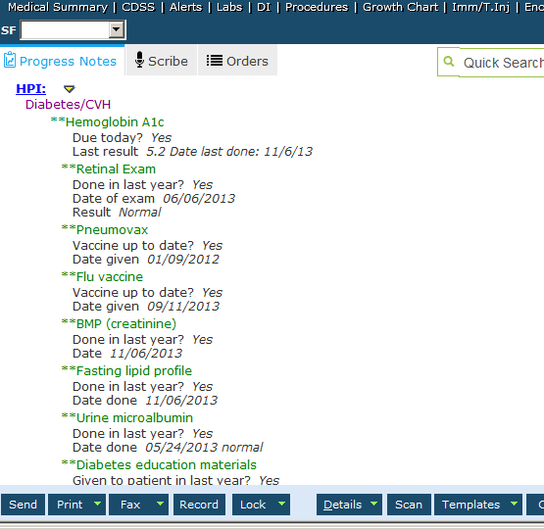
Pre-visit Planning

Slide 5
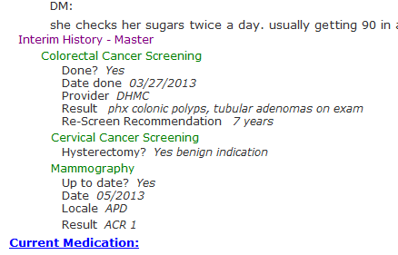
Pre-visit Planning (cont.)

Slide 6
Clinical Microsystem
A small group of people who work together on a regular basis
Sharing an information environment
Having clinical and business aims, & linked processes
Providing care to discrete subpopulations of patients
Producing performance outcomes.
The Dartmouth Institute for Health Policy and Clinical Practice
Notes:
“Clinical microsystems are the front-line units that provide most health care to most people. They are the places where patients, families and care teams meet. Microsystems also include support staff, processes, technology and recurring patterns of information, behavior and results. Central to every clinical microsystem is the patient. They evolve over time and are (often) embedded in larger organizations. As a type of complex adaptive system, they must: (1) do the work, (2) meet staff needs, (3) maintain themselves as a clinical unit.”
WRFP: 9 providers with 15 support staff, all providing primary care and cross-covering one another.
Monthly calendar of Tuesday lunchtime meetings: (All staff, Management, Providers, Clinical)
When WRFP committed to obtain an EHR, we formed an additional “Tuesday Morning Breakfast Club”
Pre-EHR
During implementation (including process-mapping)
5. Sharing information environment: Standing orders, EHR, Visit Preparation, Dashboard
The last two characterizations of a clinical microsystem – caring for discrete populations and producing performance outcomes – are the subject of the latter portion of my presentation.

Slide 7
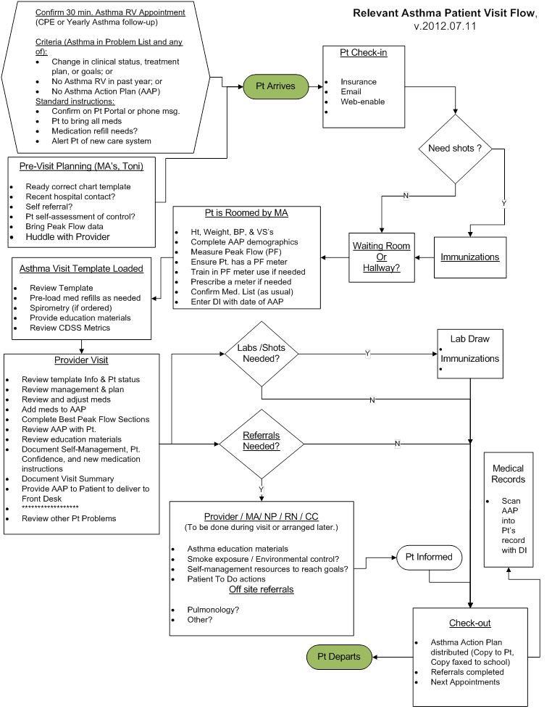
Process Map Example – Asthma visit
Others include:
Chart prep.
Pt check-in
Pt check-out
DM visit
Triage
Lab results
etc.
etc.
23 – so far…

Slide 8
“When you change the way you look at things, the things you look at change.”
Displaying measures of healthcare is essential to becoming aware of performance gaps.
Awareness is essential to formulating any intervention to improve.

Slide 9
Improving Management - Asthma

Slide 10
New Directions
Stratify populations to focus care
Clinical measures
Patient Confidence
Tracking Confidence
MA/Health Coaching
EHR enabled

Slide 11
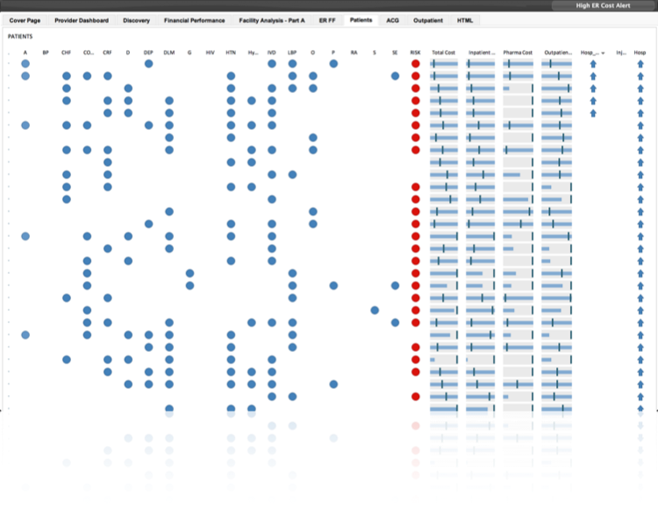
Clinically actionable data example
Notes:
An example (from EBO) of a clinically actionable dashboard for population management allowing stratification within a population for those patients most in need of more intensive services. Not easily affordable for a small independent practice, both in software purchase as well as developing in-house skill in software use. Potentially available with association with a larger organization (e.g., an ACO).

Slide 12
Patient Confidence
Notes:
An example (from EBO) of a clinically actionable dashboard for population management allowing stratification within a population for those patients most in need of more intensive services. Not easily affordable for a small independent practice, both in software purchase as well as developing in-house skill in software use. Potentially available with association with a larger organization (e.g., an ACO).

Slide 13
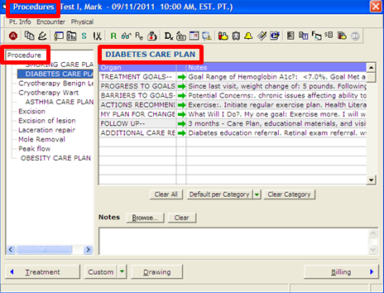
Care Plan Development
(using the Procedure Section)

Slide 14
Advocate for funding support!
Vermont Blueprint
Commercial payers
Self-funded business
Region-wide (VT + NH)

